Slide 1

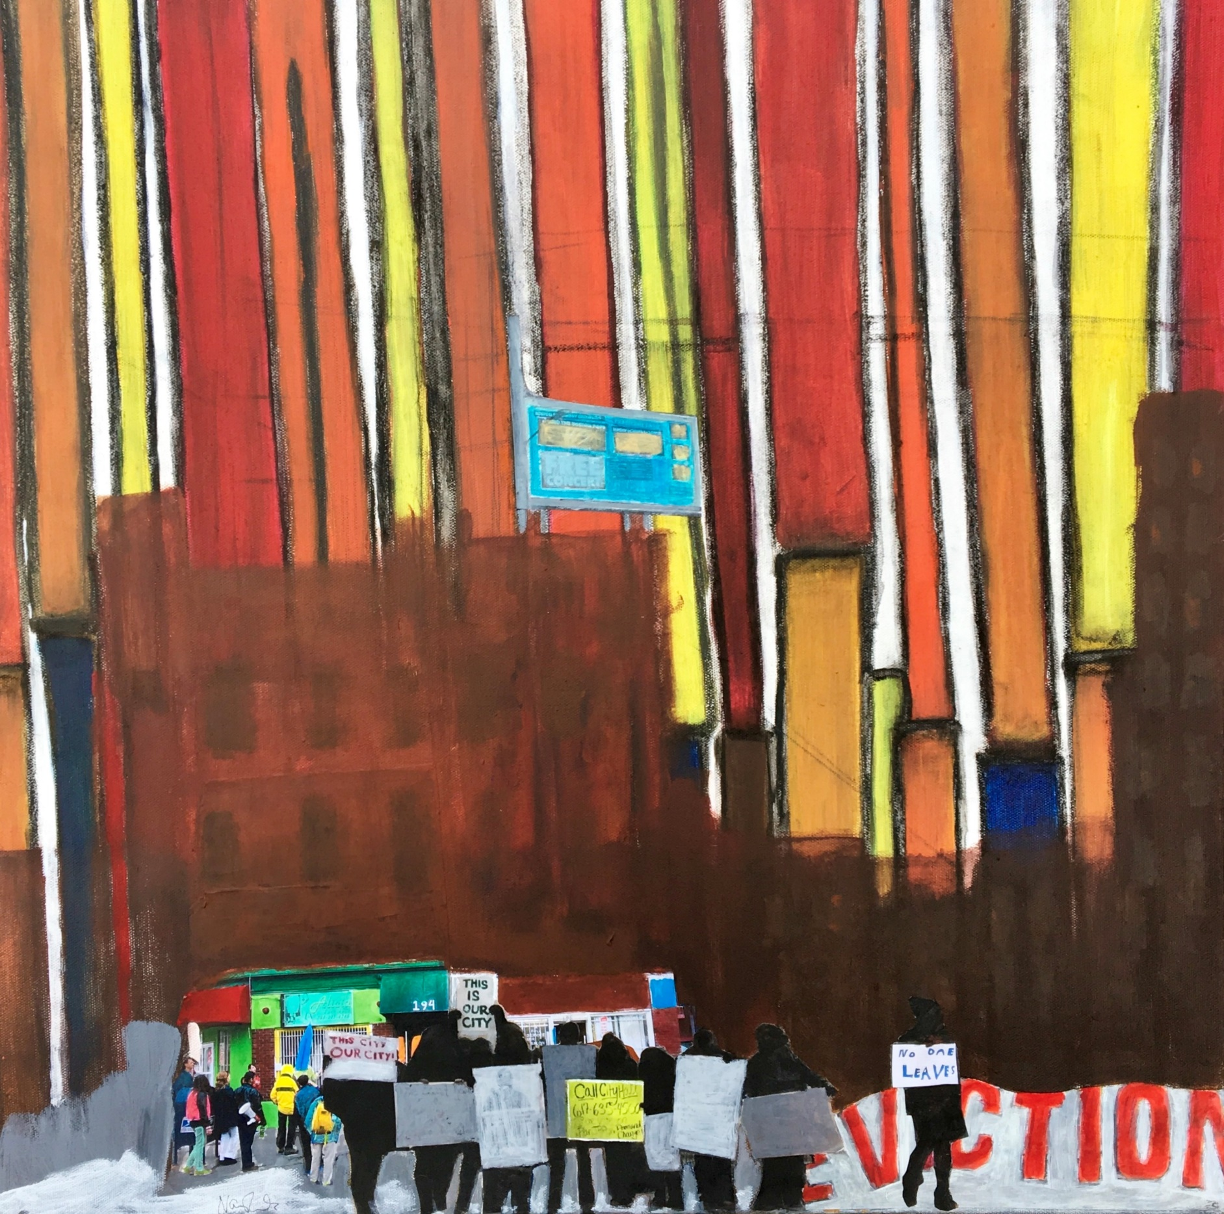

2024
ANNUAL
MEETING
November 21, 2024

Slide 2



THANK YOU TO OUR SPONSORS
PRESENTING SPONSORS
2024 Annual Meeting

Slide 3










THANK YOU TO OUR SPONSORS
PLATINUM
2024 Annual Meeting

Slide 4
THANK YOU TO OUR SPONSORS
SILVER
GOLD
CEDAC
DAVIS SQUARE ARCHITECTS
DEDHAM SAVINGS BANK
FEDERAL HOME LOAN BANK
INSOURCE
NEEDHAM BANK
POINT32 HEALTH
PRESERVATION OF AFFORDABLE HOUSING
SOMERVILLE COMMUNITY CORPORATION
BOSTON CHILDREN'S HOSPITAL
DANA-FARBER CANCER INSTITUTE
DORCHESTER BAY EDC
MASS GROWTH CAPITAL CORPORATION
M&T BANK
ROCKLAND TRUST
2024 Annual Meeting

Slide 5
THANK YOU TO OUR SPONSORS
BRONZE
AAFCPAs
AFFIRMATIVE INVESTMENTS
BANK ESB
FENWAY CDC
HARBORLIGHT COMMUNITY PARTNERS
INQUILINOS BORICUAS EN ACCION
JOE & DINA KRIESBERG
LEADER BANK
LICATA RISK ADVISORS
MUNKENBECK CONSULTING
NEW ECOLOGY, INC.
NOLAN SHEEHAN PATTEN LLP
RESONANT ENERGY
SCHWARZSCHILD CONSULTING
TD BANK
VERMONT MUTUAL INSURANCE GROUP
2024 Annual Meeting

Slide 6
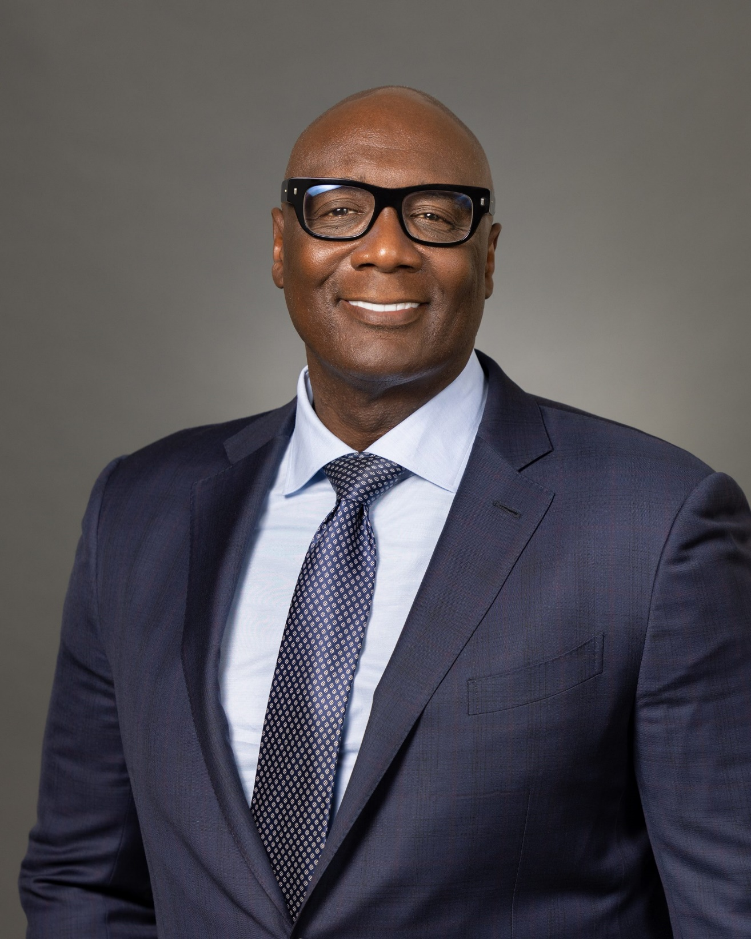
EMILIO DORCELY
MACDC Board Chair
Chief Executive Officer
Urban Edge
2024 Annual Meeting

Slide 7
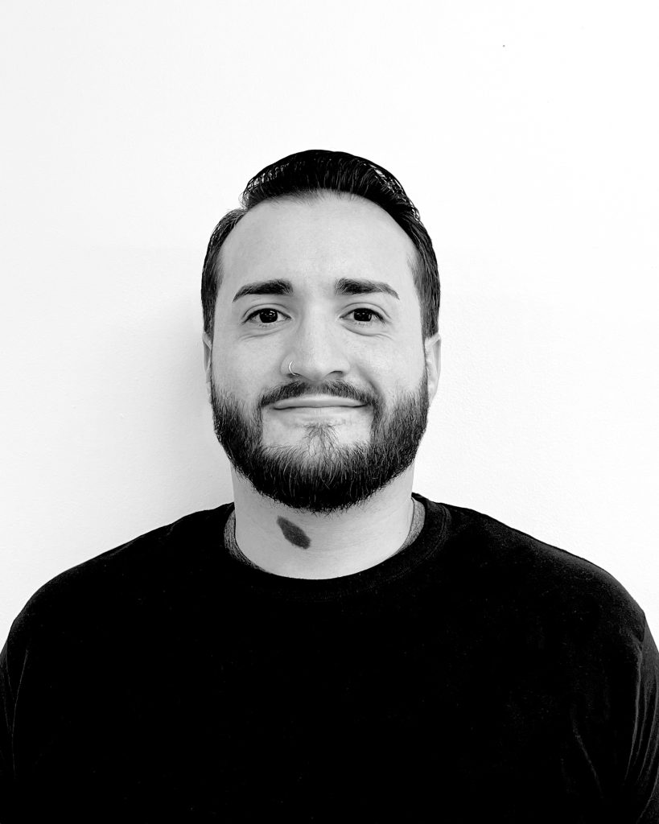
GIOVANNI AYALA
Asset Manager
Worcester Common Ground
2024 Annual Meeting

Slide 8
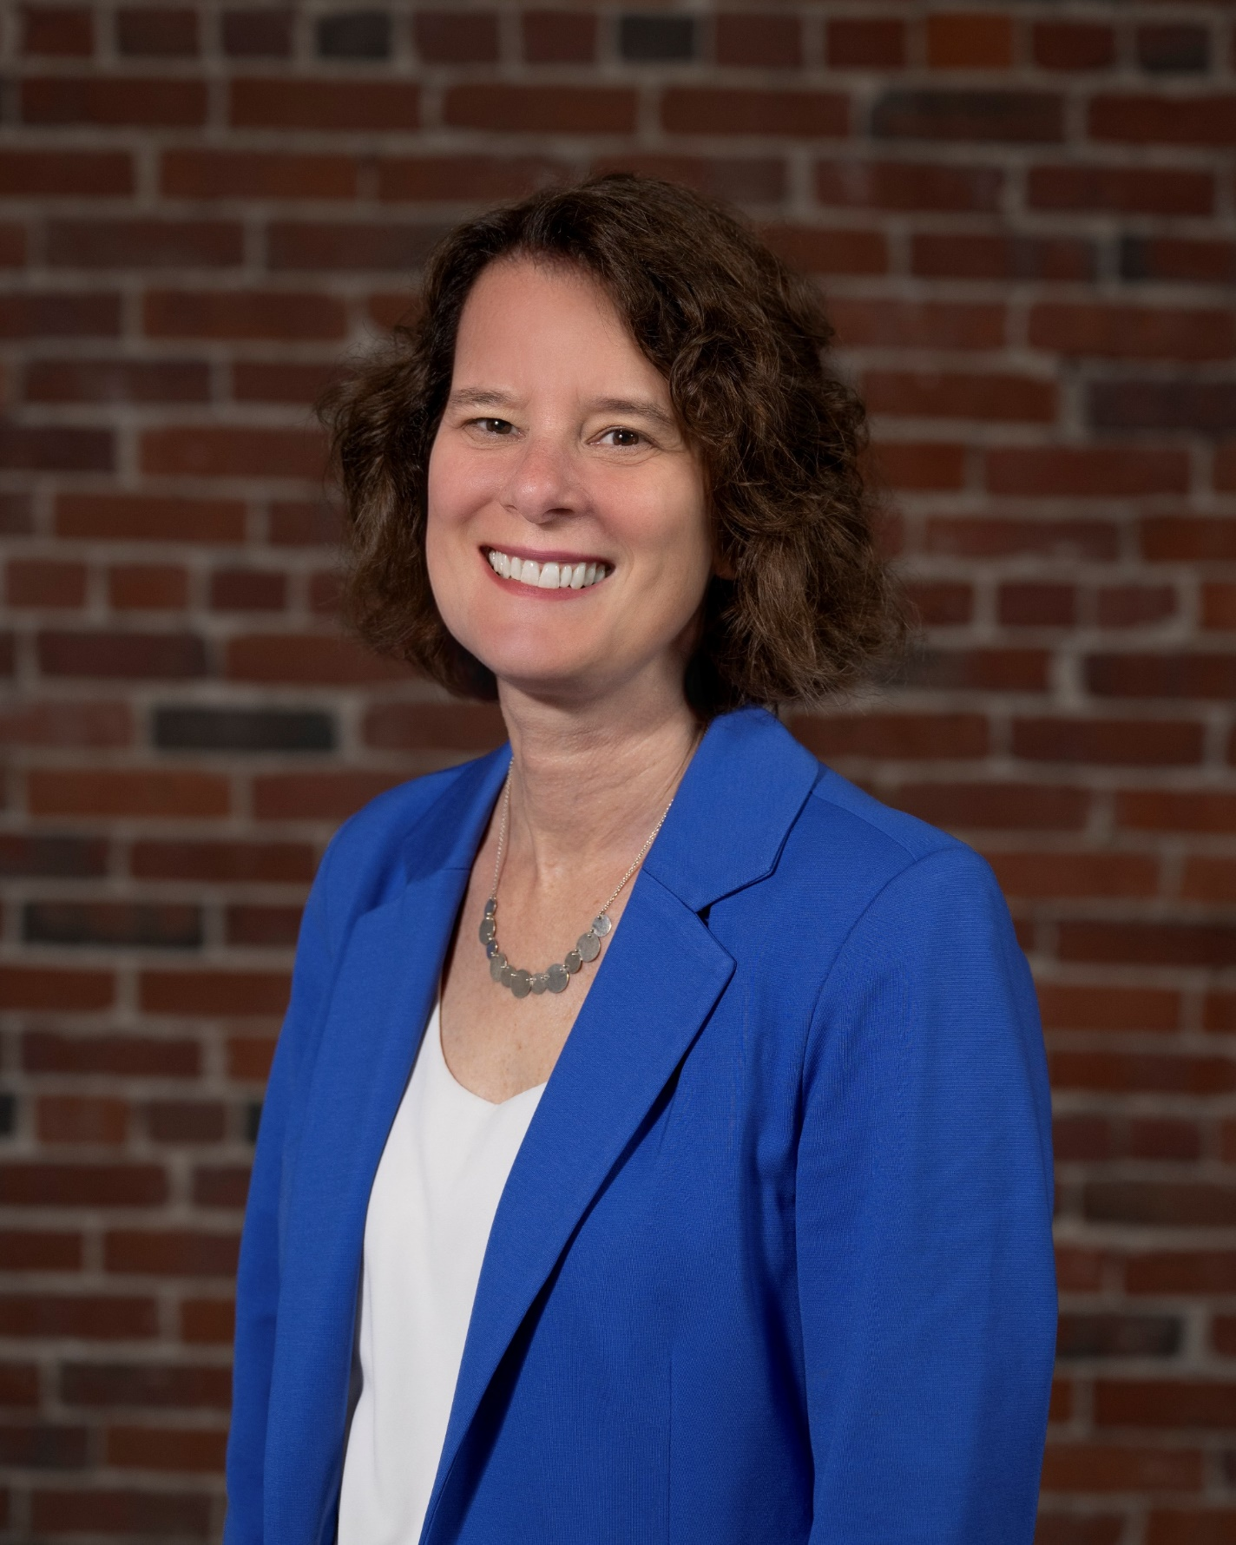
EMILY HABER
CEO
MACDC
2024 Annual Meeting

Slide 9
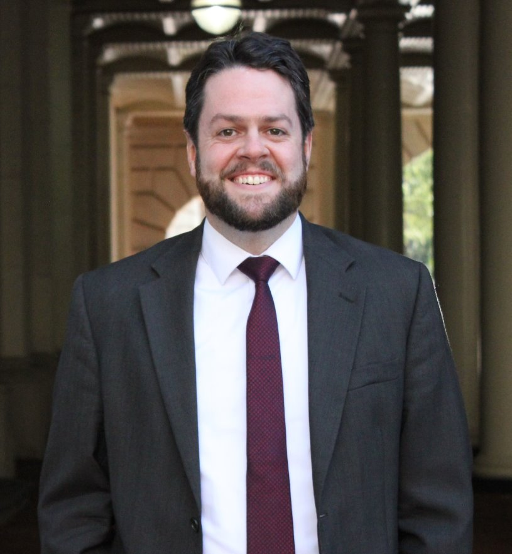
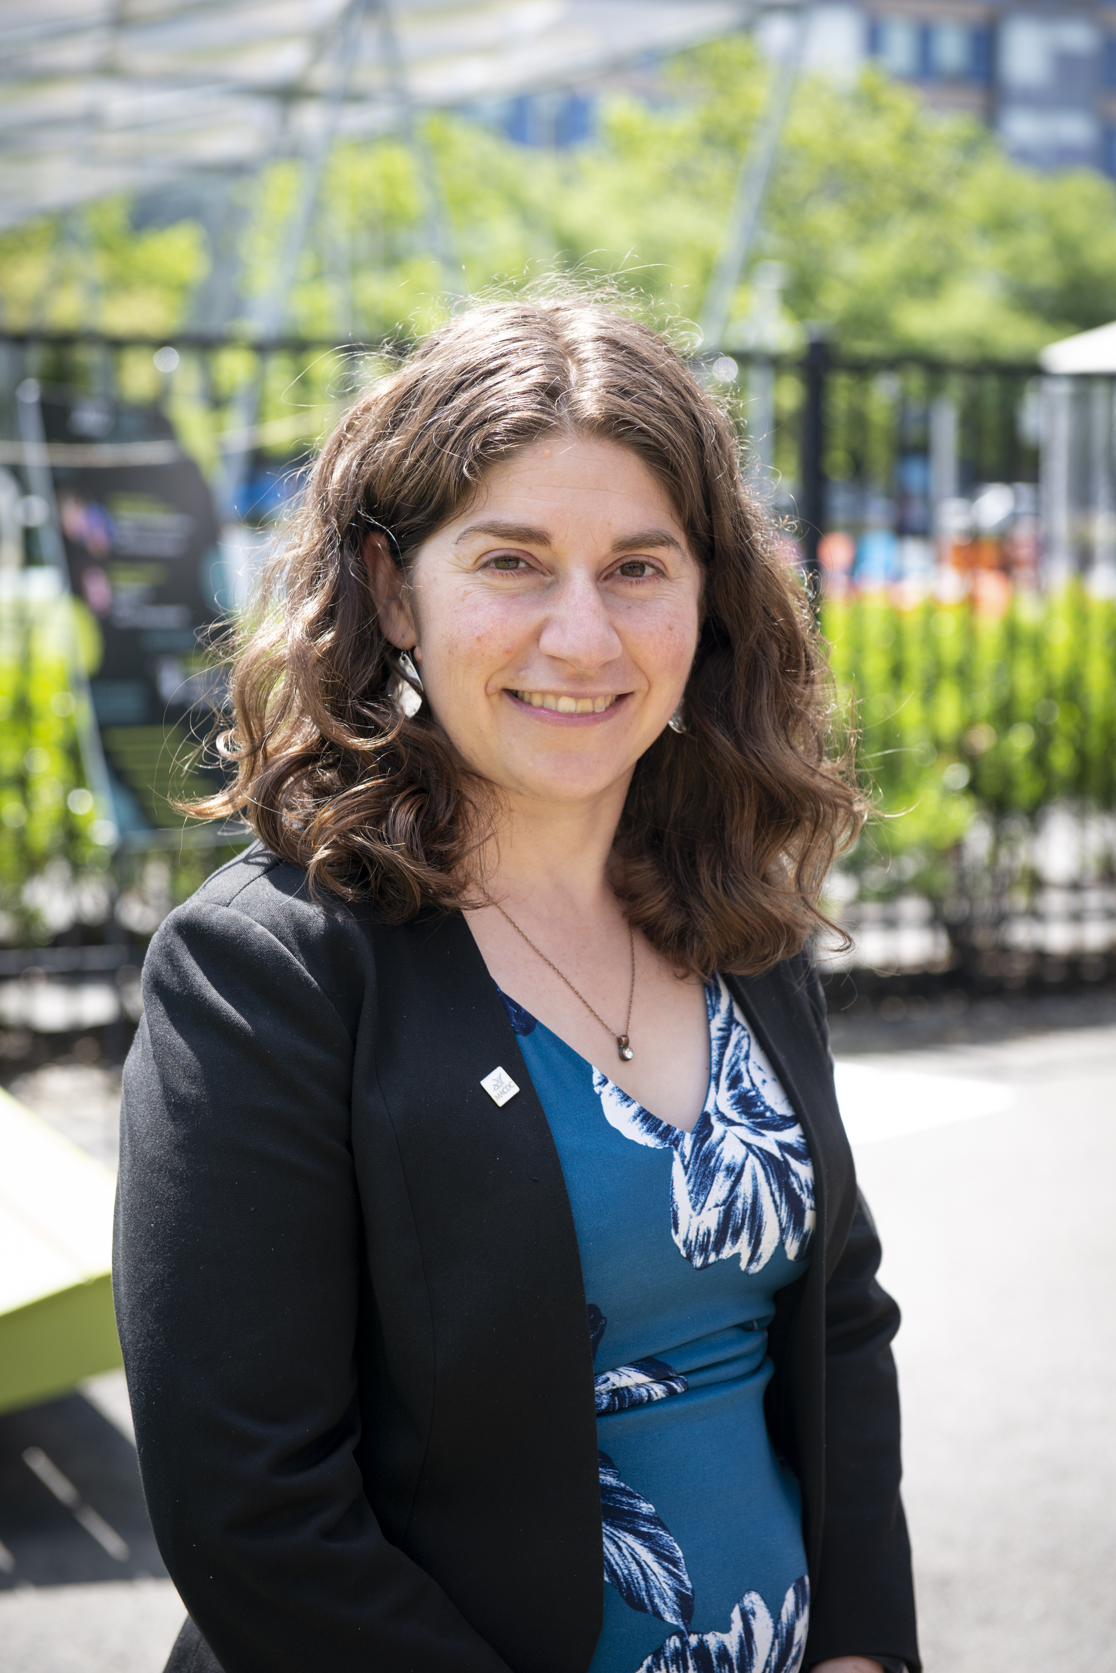
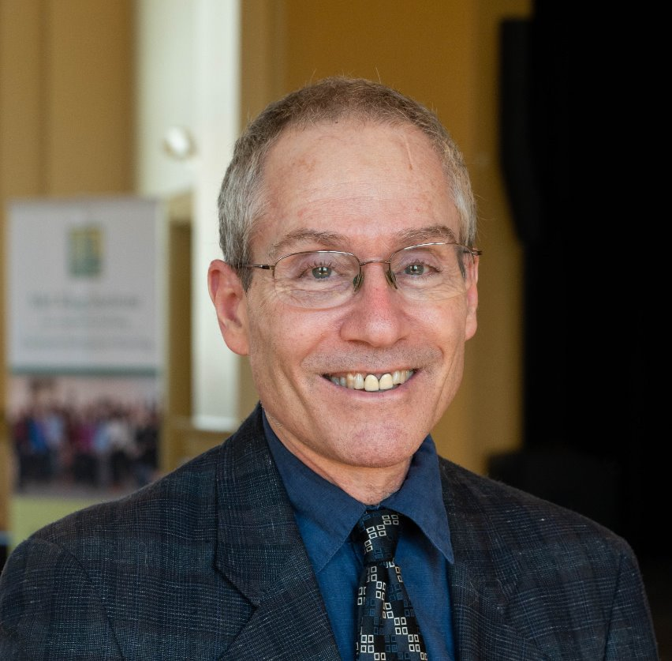
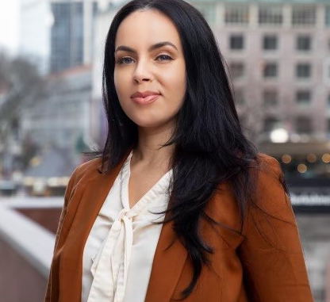
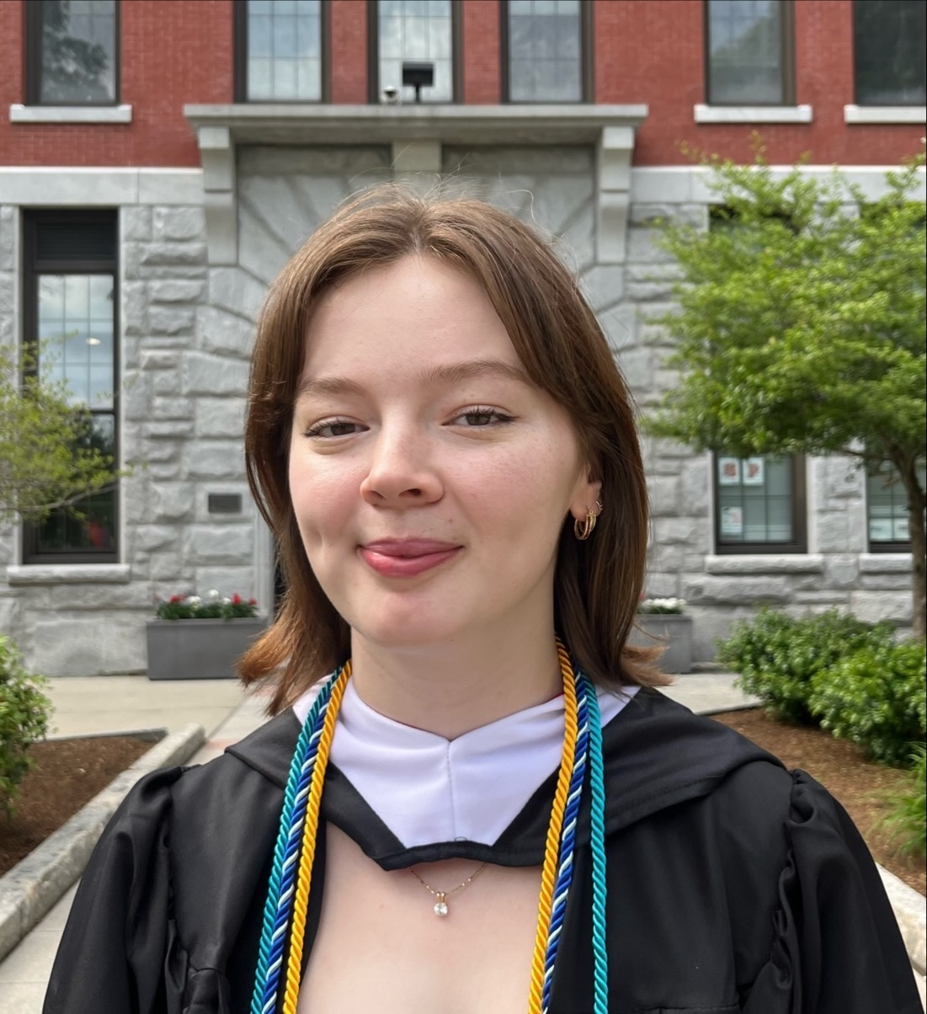
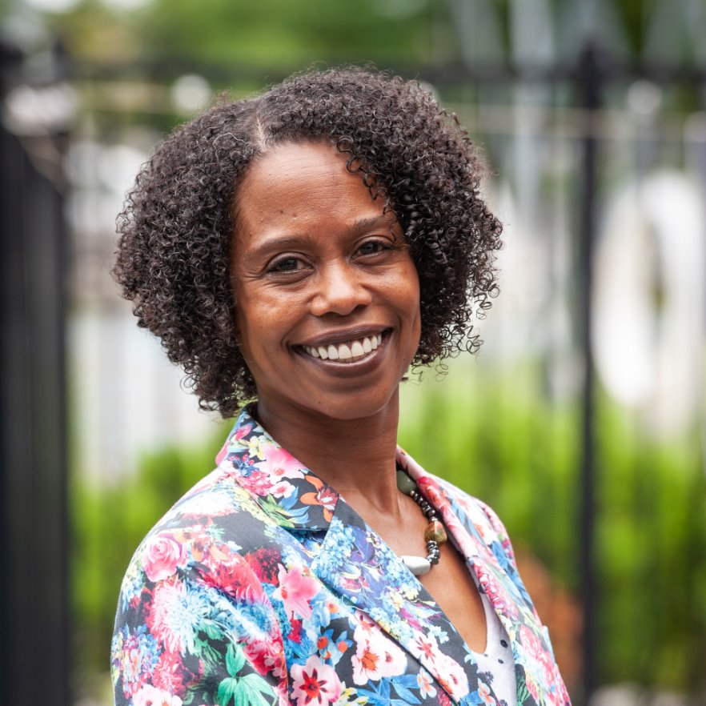
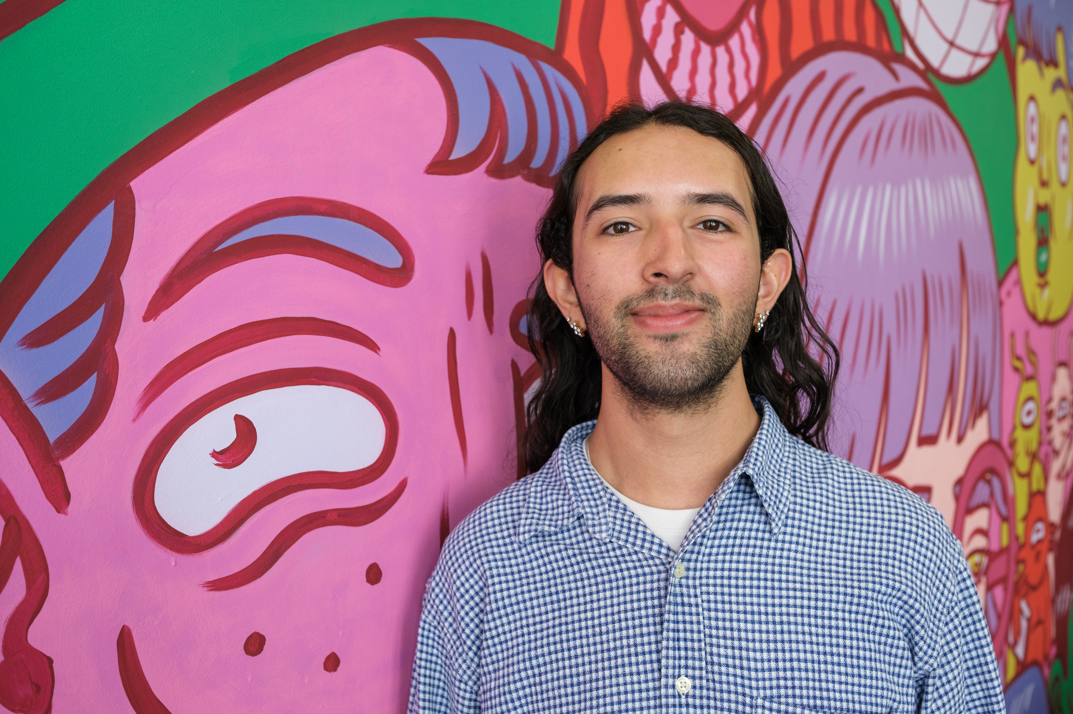
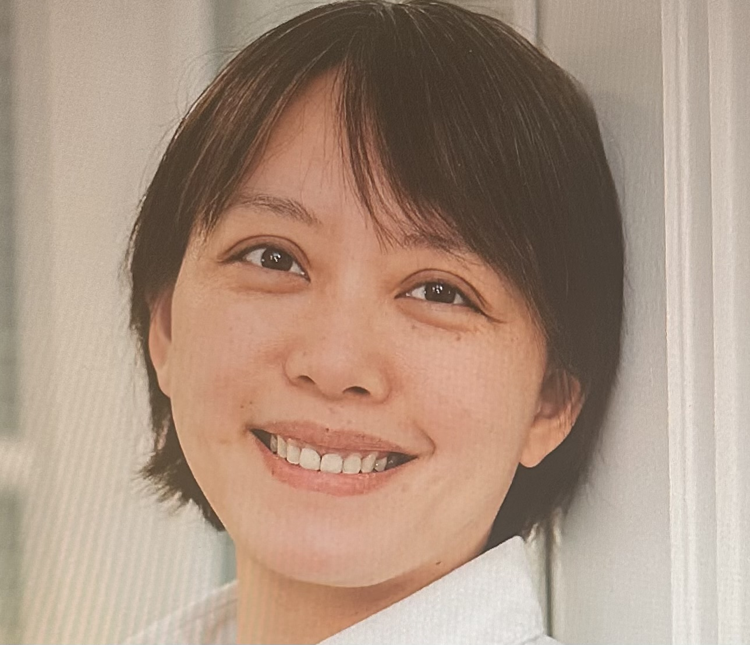
MACDC STAFF
Emily Haber, CEO
Nathanael Shea,
Director of Public Policy
Elana Brochin,
Director of Health Equity
Don Bianchi,
Director of Housing
Yari DeJesus,
Director of Economic Development
Grace Dowling,
Health Equity Intern
Shirronda Almeida,
Mel King Institute Director
Kavi Neva, Mel King Institute
Special Initiatives Fellow
Ping Wang
Staff Accountant
2024 Annual Meeting

Slide 10
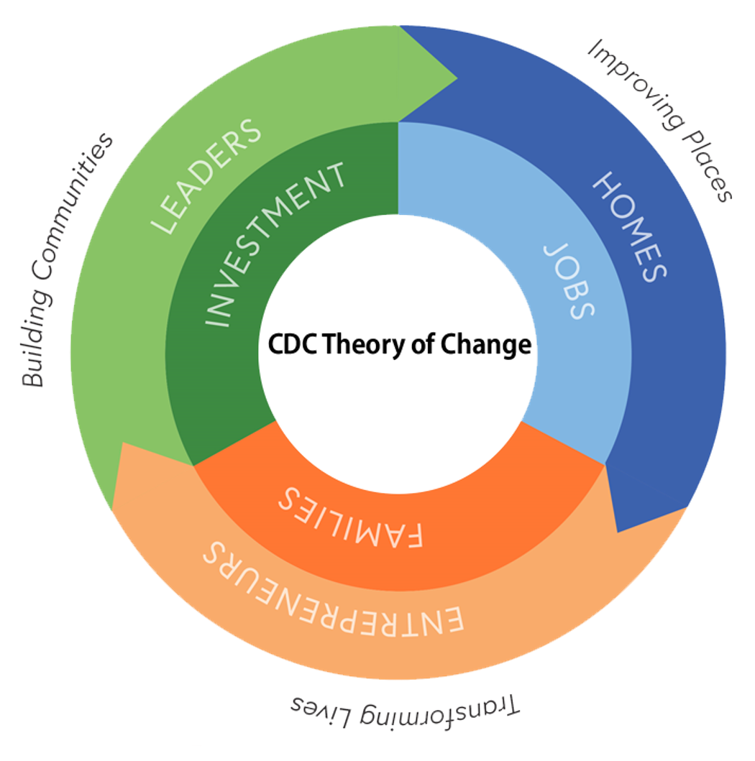
GOALs REPORT
1,610 Community Leaders Engaged
1,233 Homes Created or Preserved
4,566 Job Opportunities Created or Preserved
2,064 Entrepreneurs Provided Technical or Financial Assistance
75,937 Families Assisted with Housing, Jobs, or Other Services
$1.29 Billion Invested in Local Communities
CDC Achievements in 2023:
2024 Annual Meeting

Slide 11
MACDC PEER GROUPS
Organizer
CITC
Community Business Network
Health Equity Committee
Resident Services Coordinator
Boston Committee
32 Meetings, 910 practitioners
Housing and Real Estate
Energy Cohort
Western MA
Housing Quality and Health Task Force
Policy Committee
Executive Directors (new for FY25)
2024 Annual Meeting

Slide 12
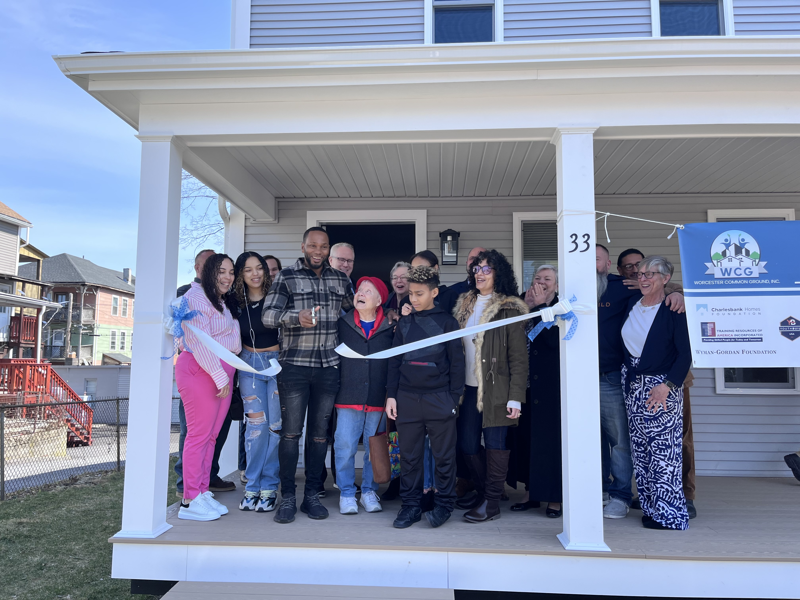
HOUSING
Accomplishments:
Achieved passage of the Affordable Homes Act, with $5 billion in bond authorizations
Secured $50 million increase in the FY25 capital budget for affordable housing
MA Division of Banks made a record-level $3.35 million in Chapter 206 counseling grants with 15 CDCs receiving $2.5 million
MACDC Board met quarterly with EOHLC Secretary Augustus
Raised funds to continue Energy Cohort convenings into FY2026
Courtesy of Worcester Common Ground
2024 Annual Meeting

Slide 13
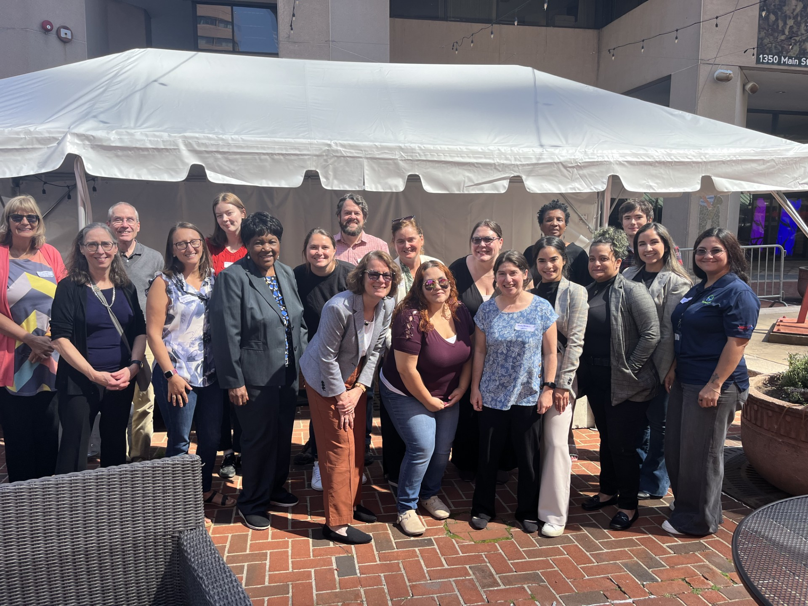
HEALTH
  Accomplishments:
  Successfully advocated for inclusion of the Massachusetts Healthy Homes Program as part of the Affordable Homes Act.
  Regularly convened several groups including MACDC's: Housing Quality and Health Task Force, Health Equity Committee, Massachusetts Healthy Homes Program Coalition, and groups of local leaders invested in housing quality in Brockton, Holyoke, and Springfield, to advance health equity.
  Gathered over twenty individuals for our annual Health Equity Field Trip.
2024 Annual Meeting

Slide 14
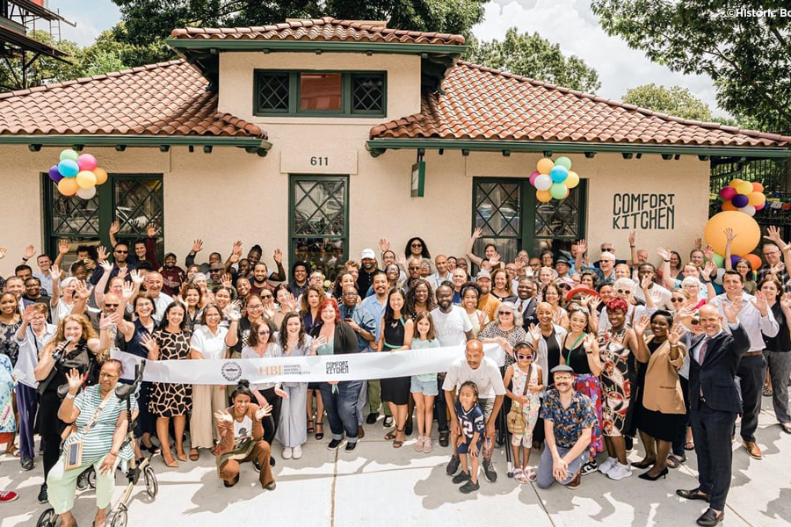
ECONOMIC DEVELOPMENT
Accomplishments:
Successfully advocated for the passage of the Economic Development Bill, which included $3.96 billion in capital programs and policy gains
$20M for the Brownfields Redevelopment Program for projects in the pipeline in addition to the $2.5M in the FY25 Capital Budget and $30M in bond authorizations
$2.5M increase in the FY25 state budget for the Small Business Technical Assistance program (SBTA)
The Community Business Network (CBN) convened quarterly
Established a comprehensive eight-week professional development training program in partnership with the Mel King Institute for small business technical assistance providers
2024 Annual Meeting

Slide 15
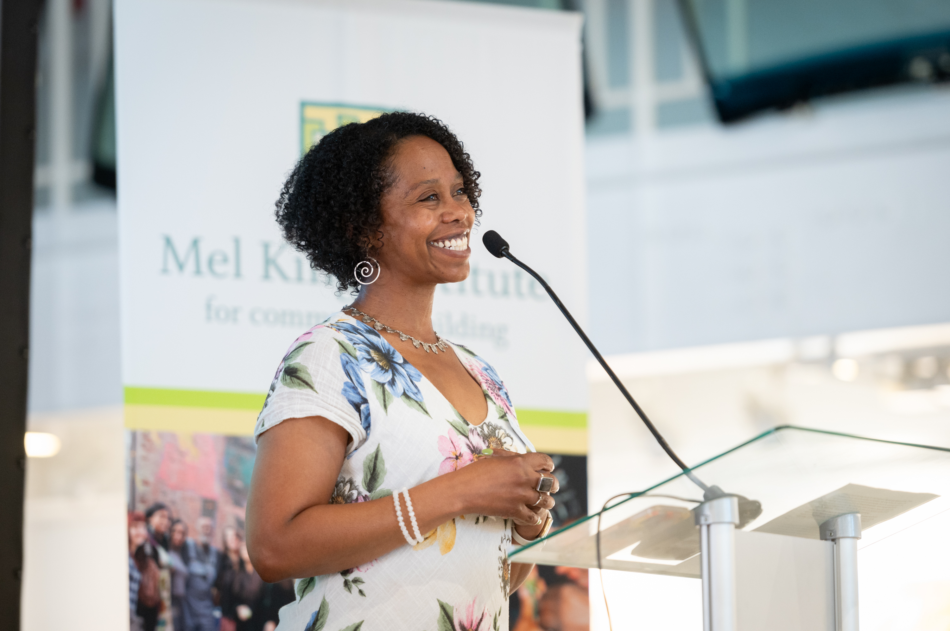
MEL KING INSTITUTE
  Accomplishments
  626 Students Trained (FY24)
  40 Courses Offered (July 2023 – Present)
  Celebrated 15 years! (2009-2024)
  Host Coalition of Housing and Asset Mangers (CHAM) Training series
  *New* Building Foundations Project Manager Training Series (LISC/ JPNDC)
2024 Annual Meeting

Slide 16

OUR JOURNEY
  2020 – initiated by MACDC’s Organizer Peer group
  Launched formally at the MACDC Annual Meeting in 2021
  Pledge Implementation Team with MACDC Members & Staff
  Adopter’s meetings, webinars and roundtables
  MACDC hosted virtual forum – Meeting the Moment
  31 Organizations adopted
  CDC Profiles sharing Pledge accomplishments / challenges
2024 Annual Meeting

Slide 17
AREAS OF THE PLEDGE
We believe…
Root Causes
…that awareness of the different types of racism and the inequities they create is key to dismantling those inequities.
Representation of Staff
… that our staff should be diverse, equitable, inclusive and representative of the communities we serve.
Representation of Board
… that our board should be diverse, equitable, inclusive and representative of the communities we serve.
Representation in Our Work
… authentic representation in our programming/services.
2024 Annual Meeting

Slide 18
2024-2025 OPPORTUNITIES
*New* Racial Equity Peer Group
Implementation Team
Adopters Meetings
Training 2025:
  Equity and Human Resources Series
  Inclusive Hiring
  Equitable Professional Development
  Building an Inclusive Workplace Culture
Chain of Change Statewide read- Be a link in the "chain of change" and host a book club!
2024 Annual Meeting

Slide 19
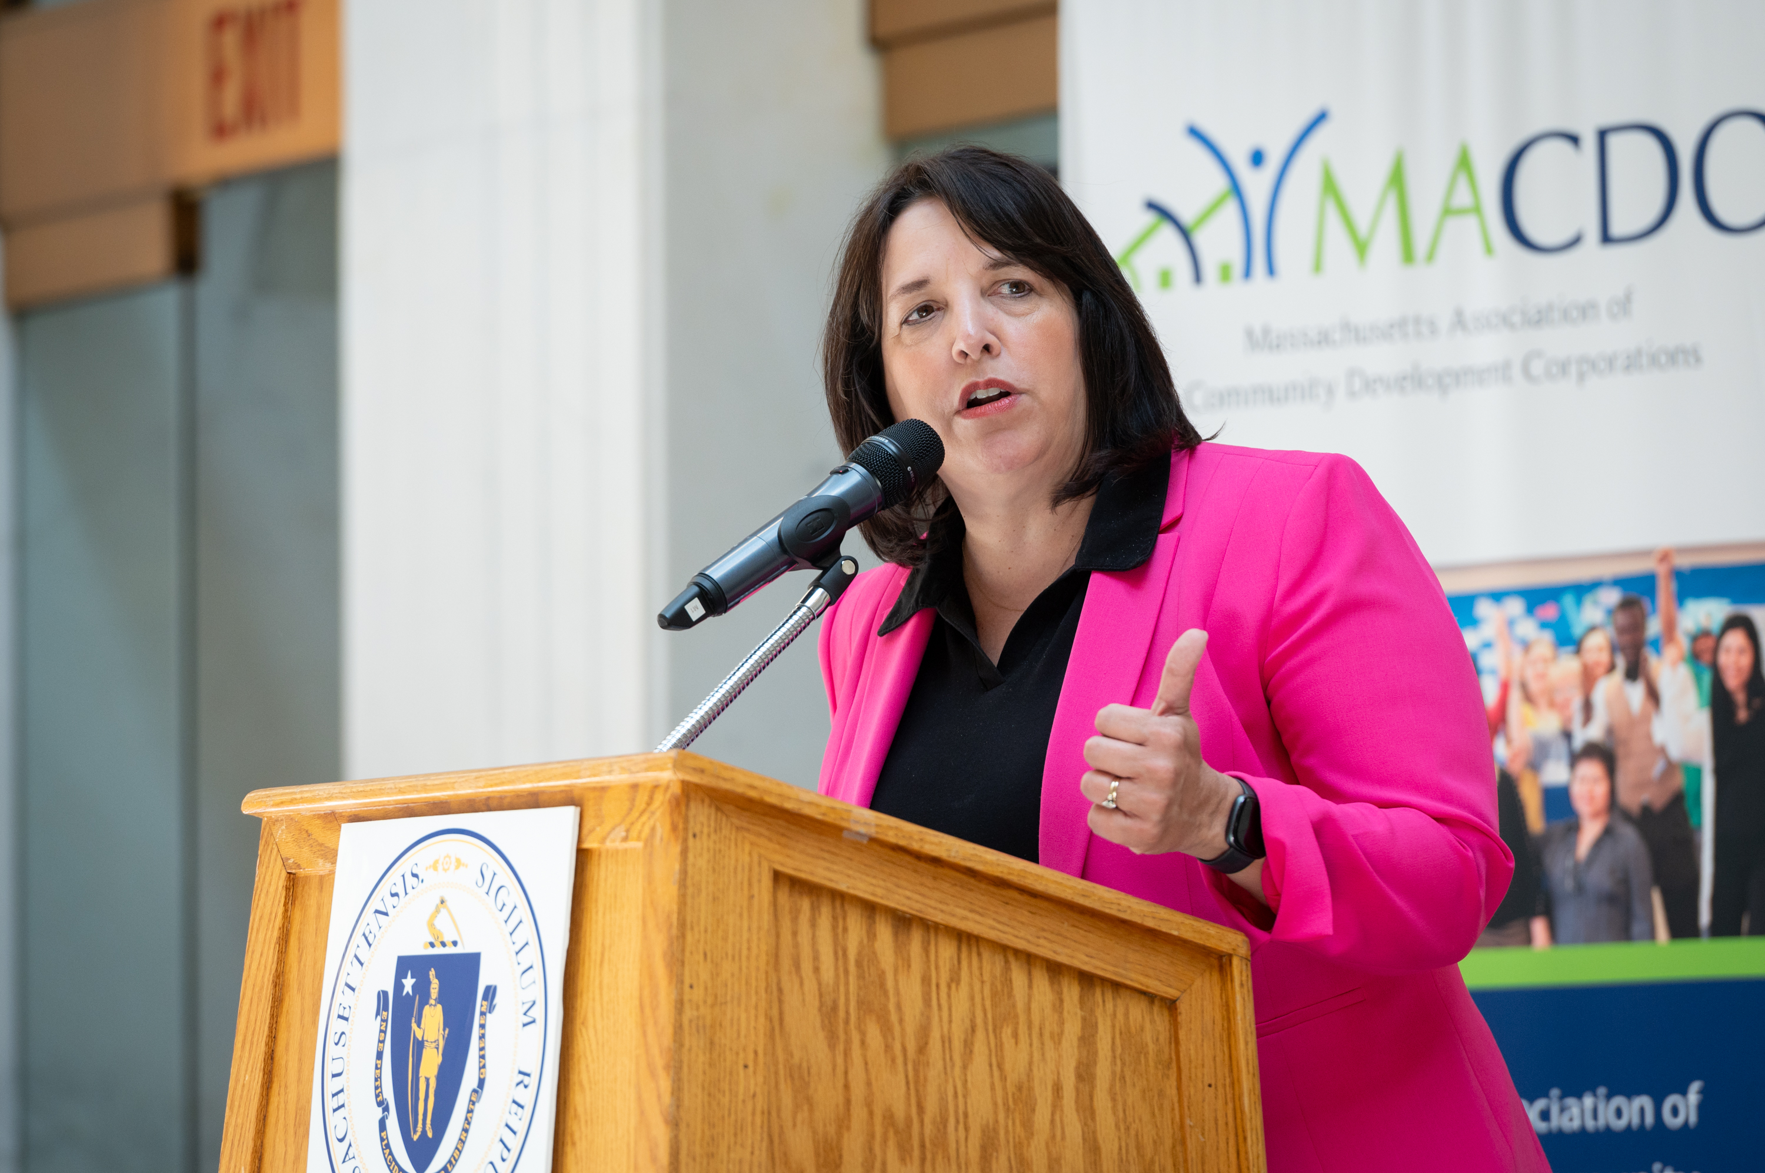
ADVOCACY & POLICY
Accomplishments this year:
Donuts with Your Delegation
2024 Lobby Day, with over 250 CDC attendees
  Save the date of April 10th for Lobby Day 2025!
$7.5 million for SBTA – an historic funding level!
Affordable Homes Act
  CITC
  MHHP
  ADUs by right
  $475 million for decarbonization and green initiatives
Economic Development Bill
  $30 million for Brownfields
  $35 million for CDFI lending
  $100 million for Rural Development Fund
2024 Annual Meeting
Notes:
Dozens of Donuts meetings
Lobby Day headlined by LG Driscoll
AHA
Call out wins
In addition to $5 billion in capital authorizations

Slide 20
2025 – 2026 ADVOCACY AGENDA PROCESS
Member Listening Sessions
Consulted with Statewide Allies
MACDC Policy Committee Recommendation
Board approved
2024 Annual Meeting
Notes:
9 Listening Sessions, by region.
34 CDCs participated.
Allies consulted: CHAPA, MAPC, MAHA, Coalition for an Equitable Economy, Community Business Network, Abundant Housing, Better Future Project

Slide 21
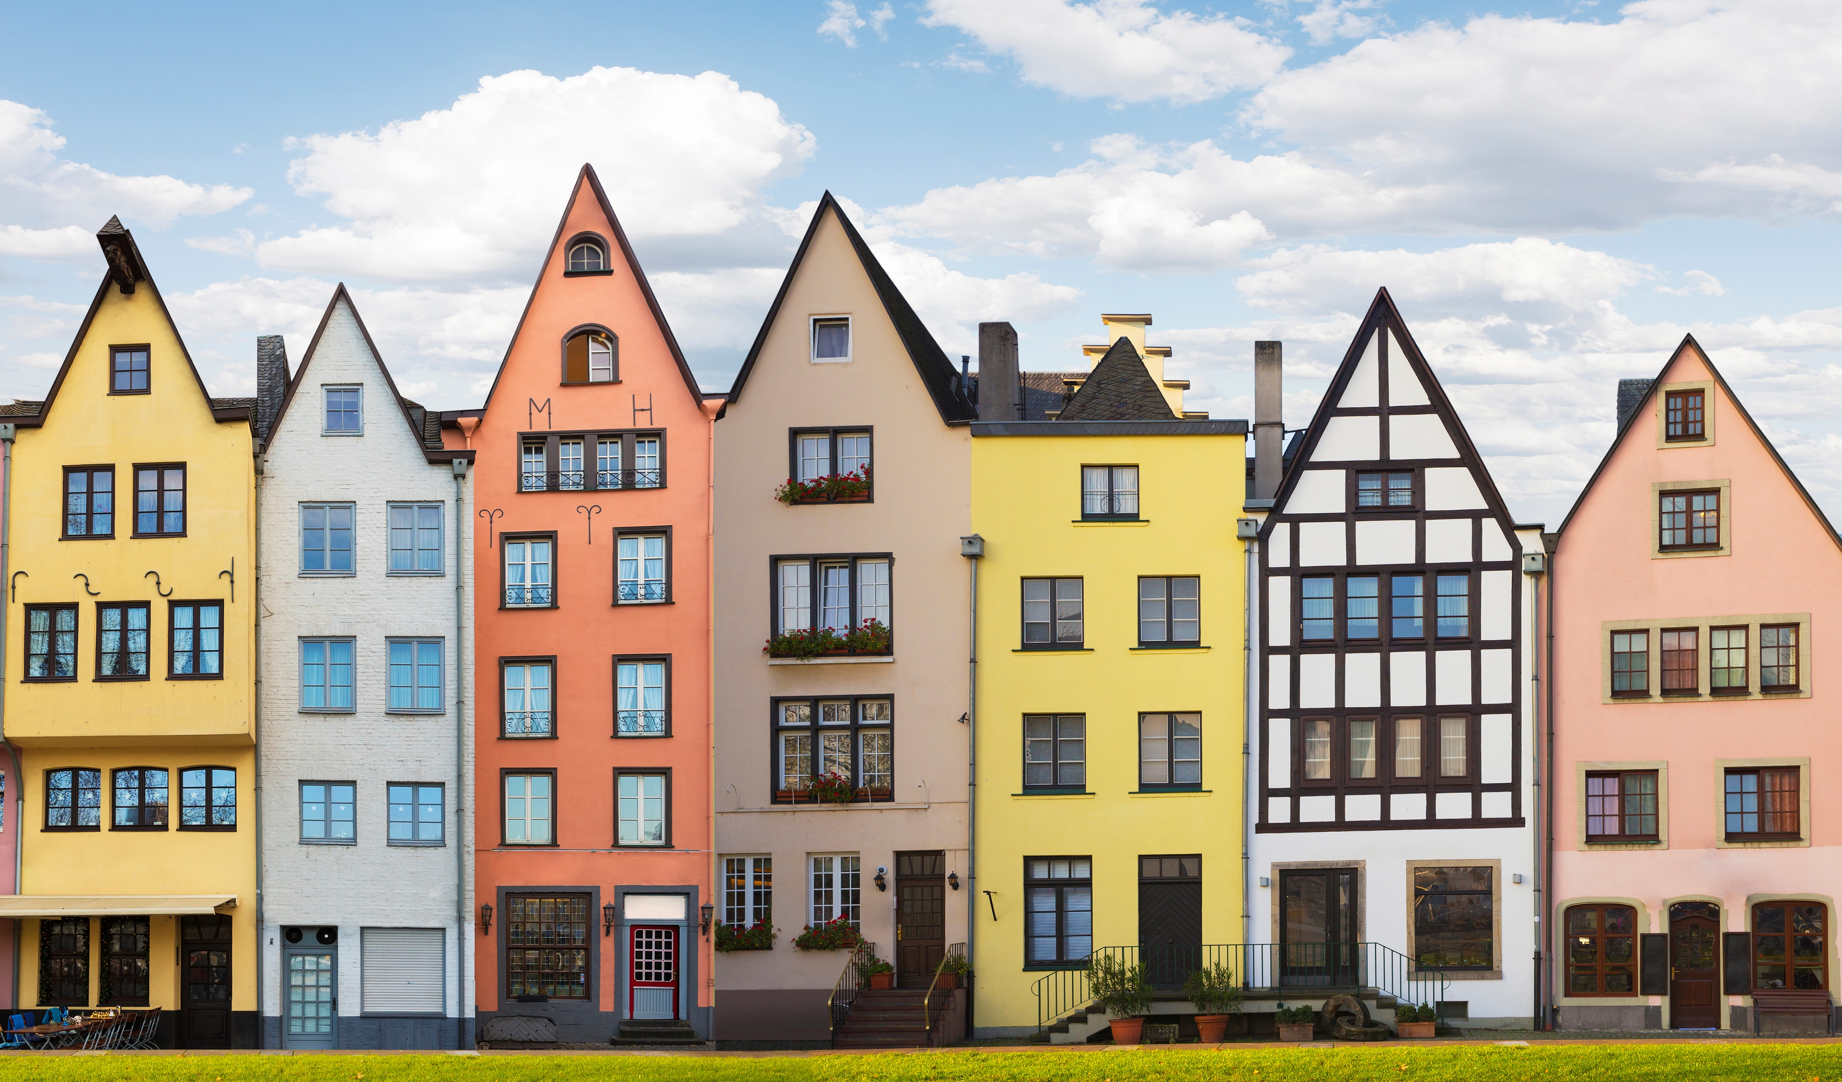


2025 – 2026 ADVOCACY AGENDA
  Production
    Transfer Fee
    Water Infrastructure
    LIHTC Volume Cap
    Zoning Reform
  Support
    TOPA
    MRVP / RAFT
    Ch. 206
  MHHP Funding
  HERO Act
  Decarb Bonding
  Zero Carbon Renovation Fund
  SBTA
  Brownfields
  Rural Dev. Fund
  Urban Agenda / Microlending / CERG
Housing
Health & Climate
Economic Development
2024 Annual Meeting
Notes:
- Many of these are pre-existing priorities, and
- Will remain nimble to threats to our communities posed by the Trump Administration.

Slide 22
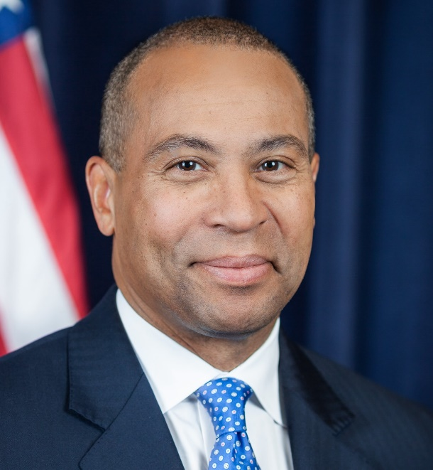
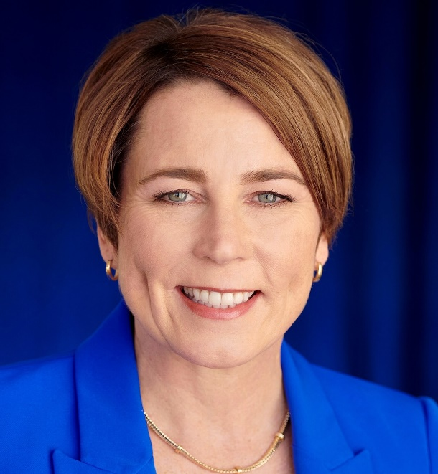
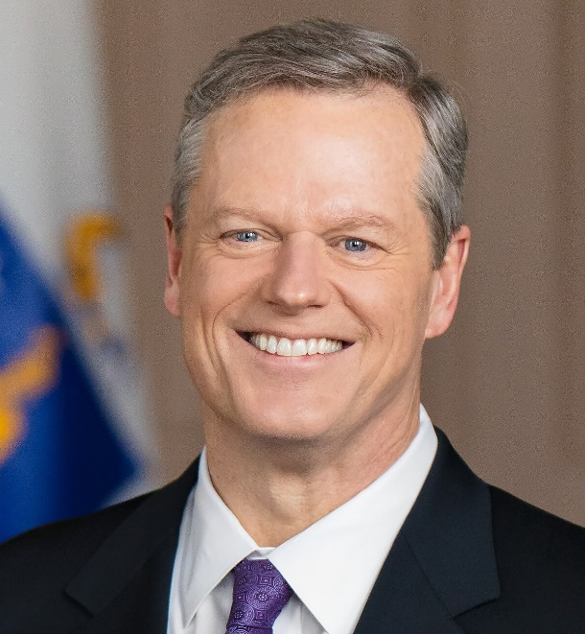
CITC: A Durable Policy Achievement
Governor Deval Patrick enacts CITC program
(cap: $3M>$6M)
Governor Charlie Baker extends sunset
(new cap $8M>$12M)
Governor Maura makes CITC permanent
(new cap $15M)
2012
2018
2024
2024 Annual Meeting
Notes:
The Community Investment Tax Credit is one of the most significant policy achievements of our sector.
Three successive administration have embraced it—a testament to its durability.
This policy has succeeded for two important reasons.
First, the impact on communities across the Commonwealth is undeniable. That’s a direct result of the hard work of the people in this room, and the work of your colleagues.
Second, our sector has effectively told the story of the CITC to both policymakers and donors.

Slide 23
CITC: A Durable Policy Achievement
2024 Annual Meeting
Notes:
This chart shows the total amount of money that your organizations raised each year beginning in 2014, the first year in which you received credits.
The state credits are equal to half of each CITC-eligible donation, so these figures represent twice the number of credits used.
That means, our sector has leveraged $67 million in state funding to support vital work.
These funds have come from donors in nearly every part of the Commonwealth, and they’ve supported projects across Massachusetts.

Slide 24
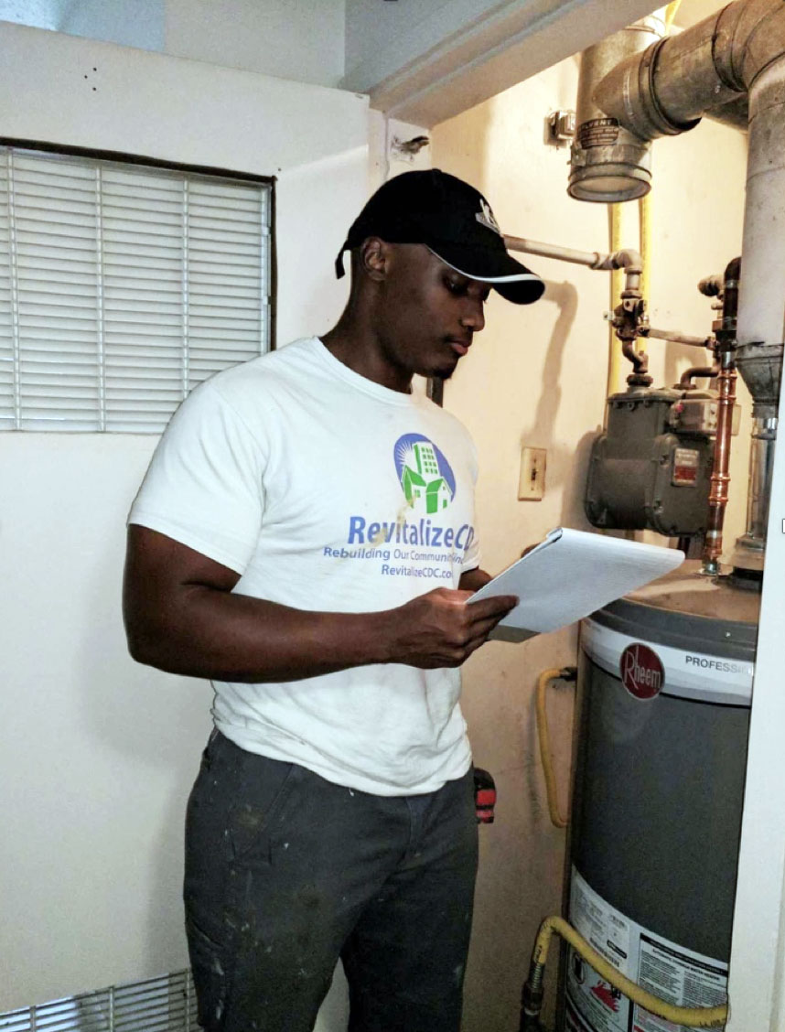
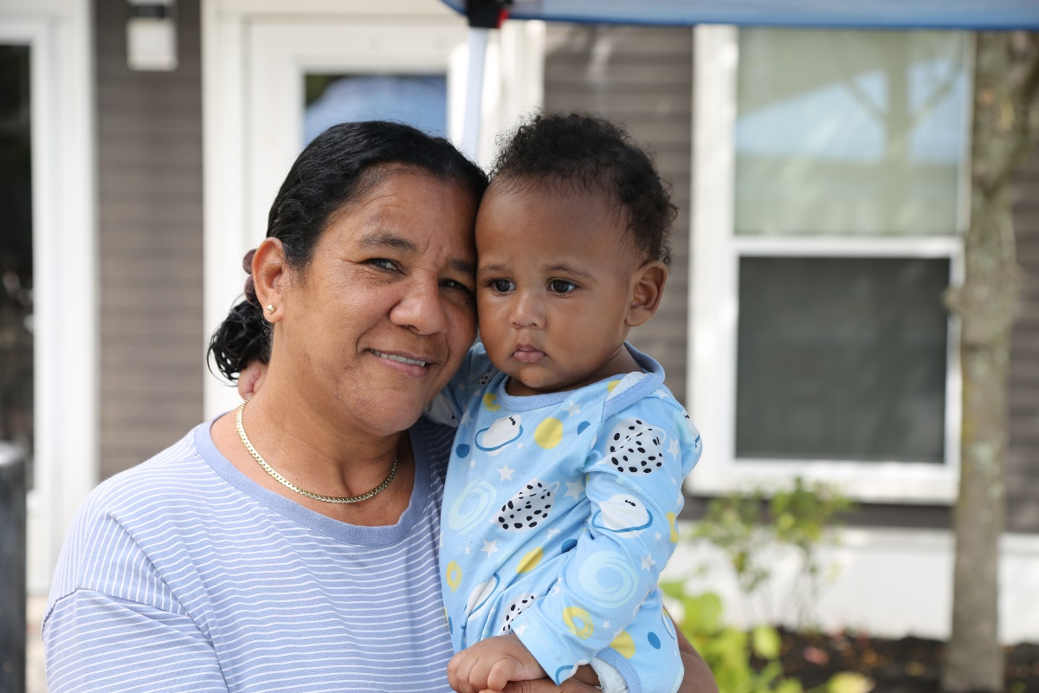
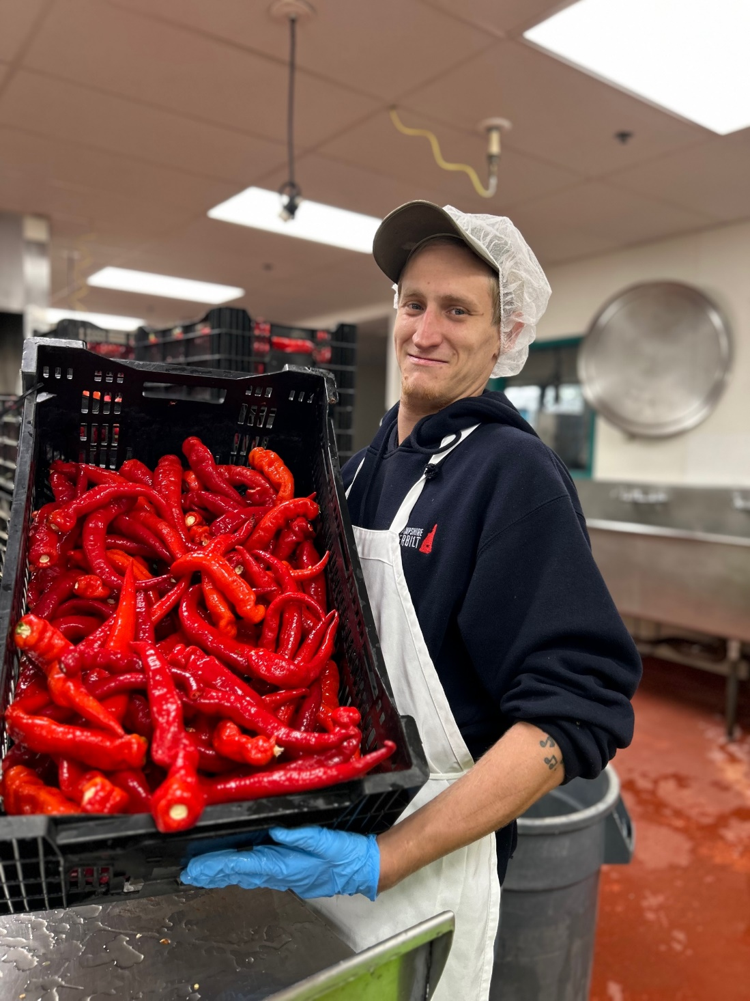
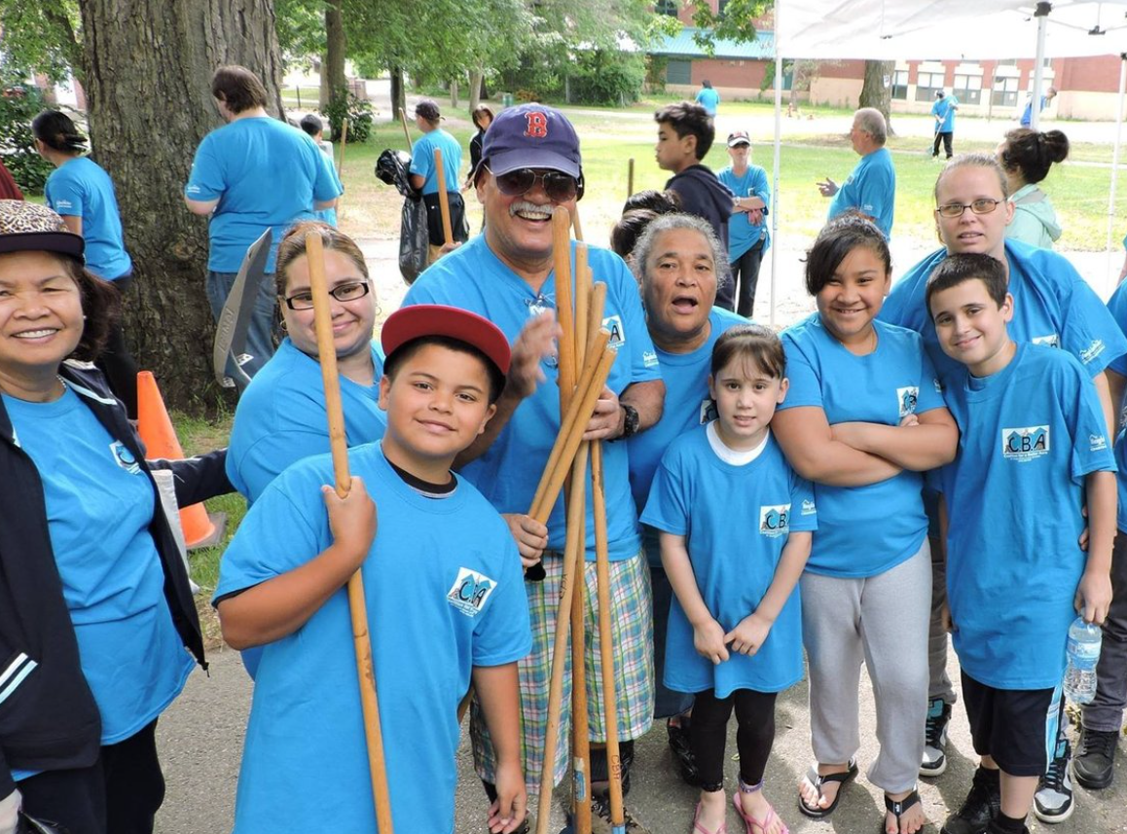
CITC: A Durable Policy Achievement
2024 Annual Meeting
Notes:
The Community Investment Tax Credit has supported nearly every aspect of our work.
It enabled CDCs to expand staffing, grow and create new programs, improve technology, provide training and professional development, and invest in physical infrastructure to support our work.
It also contributed to affordable housing development and upgrades for many organizations.
Some of you have shared anecdotes of how funds from the CITC have enhanced your work. Just four examples:
Revitalize CDC’s Healthy Homes program to improve indoor air quality and energy efficiency in Springfield
TND’s work to provide high quality affordable housing in Chelsea
CBA’s annual Acre Clean Up in Lowell
Franklin County CDC’s Western Massachusetts Food Processing Center, an incubator for food-related small business in Greenfield.

Slide 25
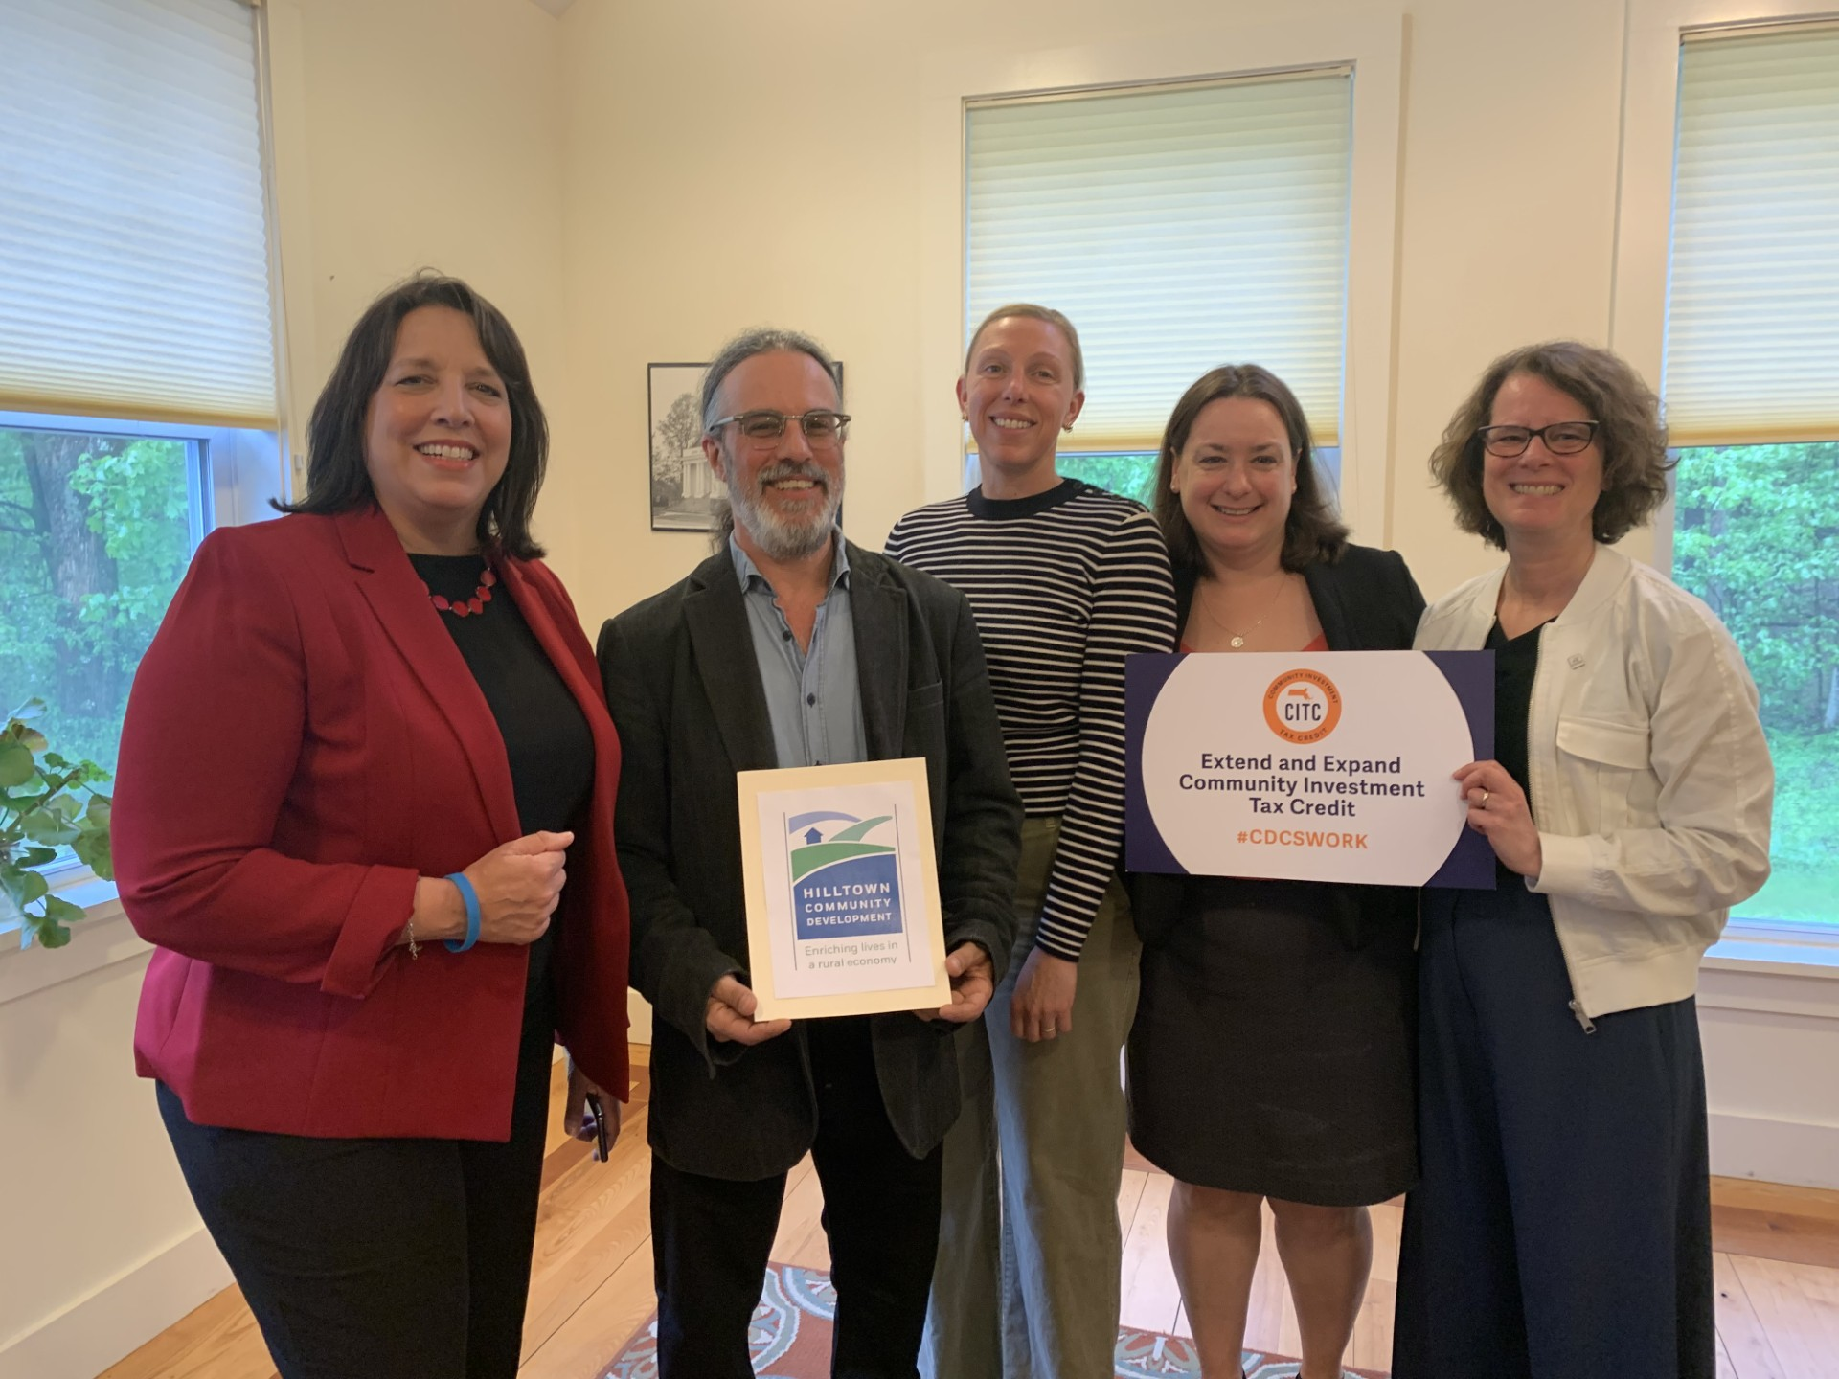
CITC: A Durable Policy Achievement
$30 Million in eligible donations
MACDC is here to help!
2014
2025
2024 Annual Meeting
Notes:
The next year presents an unprecedented opportunity to make use of the CITC
With the program now permanent, we can build multi-year fundraising plans and extend our reach to new supporters
We recently spoke with a few CDCs about how to communicate the value of the CITC to potential donors, and we plan to engage more of you soon.
You’ll hear more from us in the coming months, so stay tuned!

Slide 26
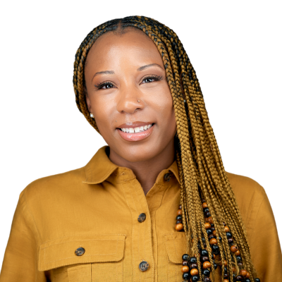
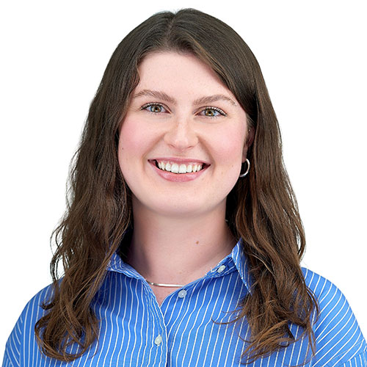
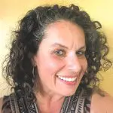
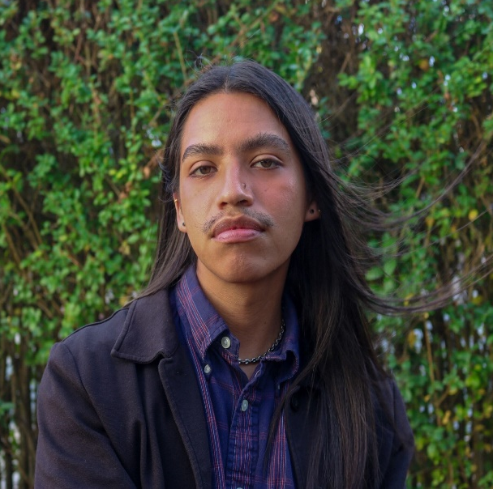
CDC Fireside Chat:
STRATEGIES FOR COMMUNITY TRANSFORMATION
PANEL
Kimberly R. Lyle
Chief Executive Officer
Dorchester Bay EDC
Kendra Beaver
Climate Justice Coordinator
Fairmount Indigo CDC Collaborative
Melissa Fales
Executive Director
Quaboag Valley CDC
Leo Ruiz Sanchez
Lead Community Organizer
Fenway CDC
2024 Annual Meeting

Slide 27
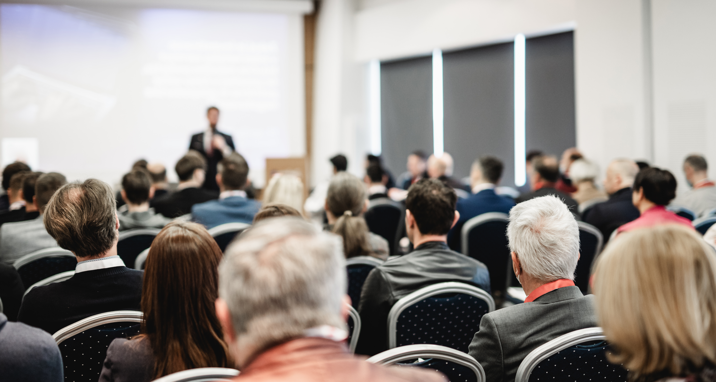
BREAKOUT ROOMS
Wealth Building Programs: How CDCs are addressing the racial wealth gap – Room 401
Local Organizing Around Affordable Housing: How Two CDCs are Flipping the Script – Suite A (4th floor)
The Past, Present and Future of MACDC’s Engagement in the Health Equity Space – Ballroom
Collective Action: Racial Equity Peer Group Launch – Room 320
2024 Annual Meeting

Slide 28
2025-2026
MACDC BOARD ELECTION
2024 Annual Meeting

Slide 29
2025-2026 MACDC BOARD NOMINATIONS
BOARD MEMBERS UP FOR RE-ELECTION AND NEW MEMBERS (TO SERVE THROUGH FALL 2026) | RETURNING BOARD MEMBERS TO SERVE THROUGH FALL 2025
Colleen Loveless, Revitalize CDC (West) Rafael Mares, The Neighborhood Developers (Greater Boston) Gonzalo Puigbo, Somerville CC (Greater Boston) Suneeth John, Fenway CDC (Boston) Teronda Ellis, JPNDC (Boston) Erika Hernandez, ACT Lawrence (Northeast) Alexis Breitnecher, Valley CDC (at-large) | 8. Gail Latimore, Codman Square NDC (Boston) 9. Marc Dohan, NewVue Communities (Central) 10. Robert Corley, NeighborWorks Housing Solutions (Southeast) 11. David Christopolis, Hilltown CDC (West) Angie Liou, Asian CDC (at-large) Kimberly Lyle, Dorchester Bay EDC (Boston) Emilio Dorcely, Urban Edge (Boston) Jay Coburn, Community Development Partnership (Southeast)
MACDC OFFICERS
Chair – Emilio Dorcely, Urban Edge Vice Chair – Kimberly R. Lyle, Dorchester Bay EDC Treasurer – Gonzalo Puigbo, Somerville CC Clerk – Rafael Mares, The Neighborhood Developers

Slide 30
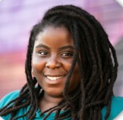

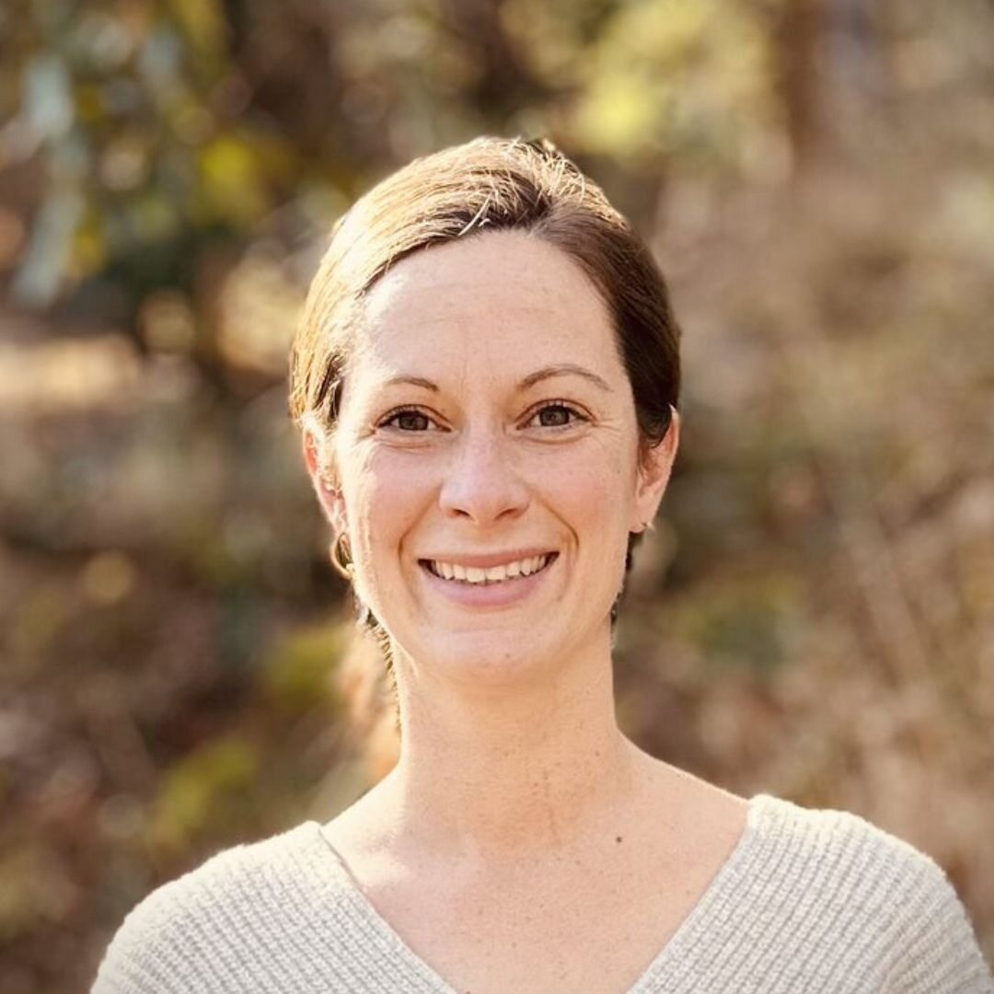
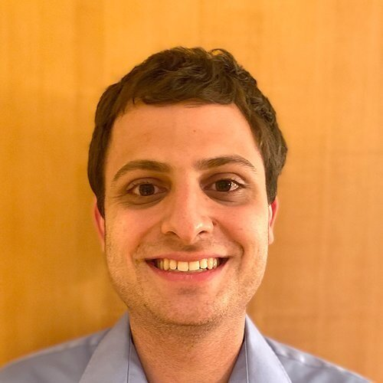
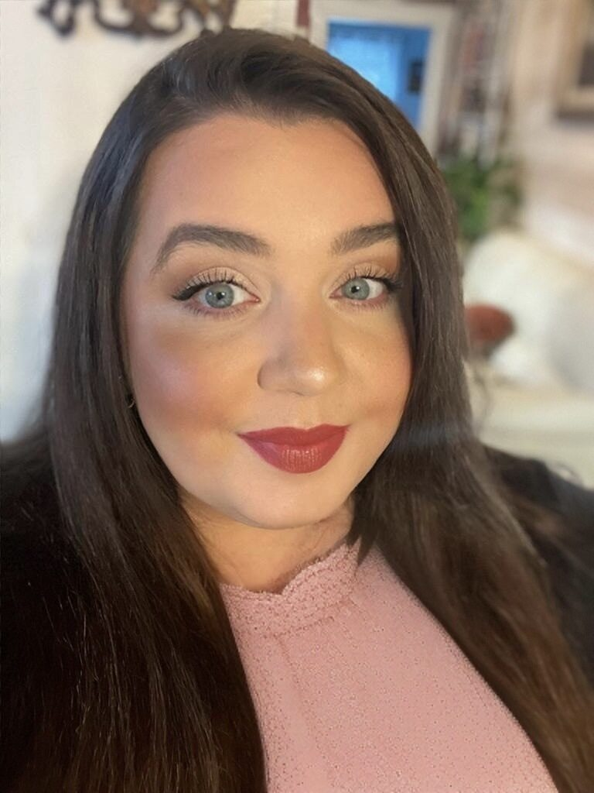
RISING STAR AWARDS
JASMINE GRADDY
LEO RUIZ SANCHEZ
KATE MINIFIE
KAVISH GANDHI
AMANDA GLENNON
2024 Annual Meeting

Slide 31
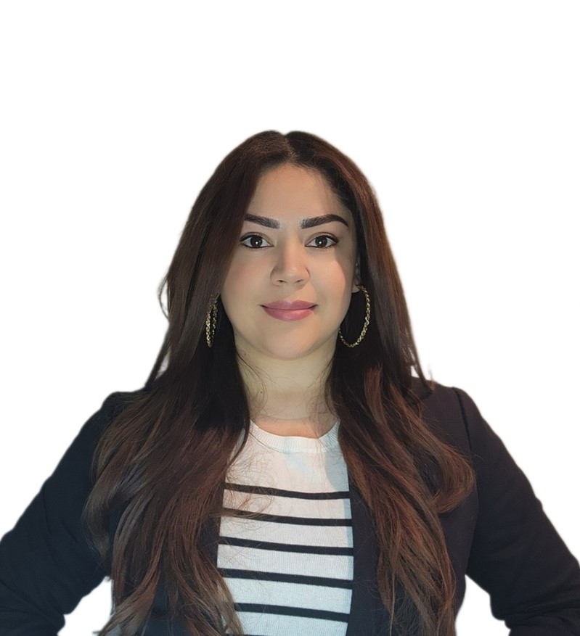
RICANNE HADRIAN AWARD
E. Ricky Guerra
Director of Real Estate Development
Jamaica Plain Neighborhood Development Corporation
2024 Annual Meeting

Slide 32
CDC ROLL CALL
Stand at one of the two mics
ONE speaker per CDC
15 seconds to share
Note one project or initiative
Roll Call Example:
Roll Call Template:
I am __________________________ (name) and I am (a board member/staff title/leader) at ________________________ (organization) and next year we will ____________________
______________________________________________________.
Remember we want people to leave the Annual Meeting feeling energized and inspired by what CDCs have planned for 2025!!
I am Juan Suarez and I am the board chair at the XYZ CDC this winter we break ground on a senior housing development in Anytown, MA.
2024 Annual Meeting

Slide 33

THANK YOU FOR ATTENDING THE 2024
ANNUAL MEETING
Save-the-Date for MACDC Lobby Day, April 10, 2025

