Slide 1


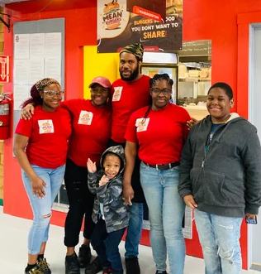

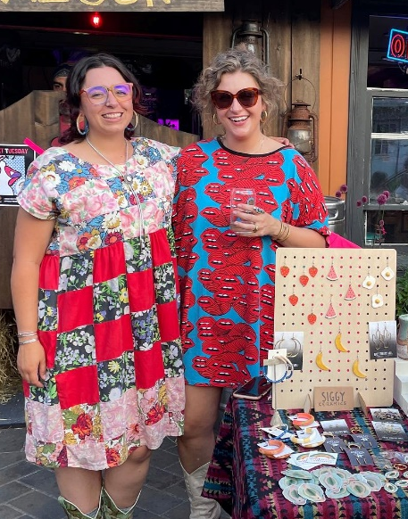
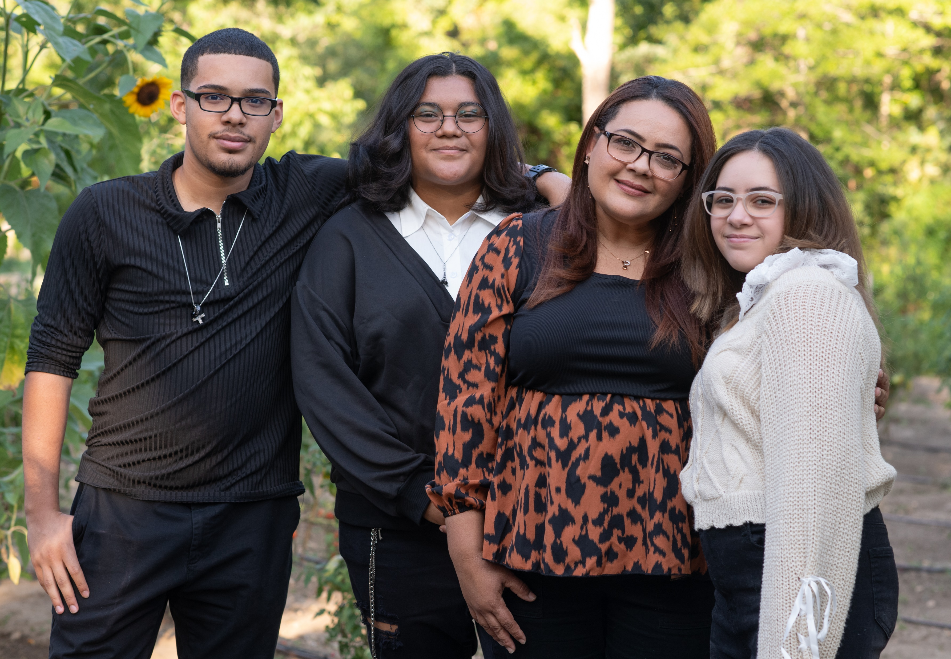
Creating opportunities for people to
live, work, and thrive on the Lower and Outer Cape.

Slide 2

Lower Cape Community Housing Partnership
Lower Cape Housing Institute (LCHI)
Project 365
Public Education Campaign
  Workshops & Peer Groups
  Annual & Special Town Meeting Summaries
  Under One Roof Newsletter
  Community Engagement & Advocacy
  Get Out the Vote
  Build public support for housing

Slide 3
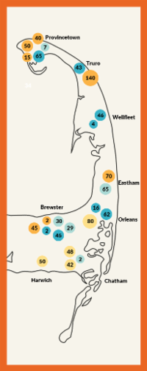
LCHI Outcomes
Since 2017:
441 participants
450+ housing-related articles passed at Town Meeting
$110 million+ allocated to housing & related articles
7 of 8 towns hired dedicated staff (Housing Coordinators)
Increased collaboration, information sharing, and prioritization of housing across the region
Regional pipeline of close to 1000 units in next 5-10 years
Monthly newsletter with 850 subscribers
CPC funding from all 8 towns
Image: CDP Housing Pipeline 2024

Slide 4

Project 365 Outcomes
Year 1:
21 participants across 2 town cohorts
Education on Town Meeting, Letters to the Editor
LTE campaign: 6 published, 1 Editorial, 1 Op-Ed
Text banking & flyering
9 speakers at Town Meeting
Passage of all articles supported by both towns
Creation of external collateral & internal SOPs
Multi-year grant funding from MA CHHAF
Image: CDP Housing Pipeline 2024

Slide 5
Lessons Learned & Next Steps
Relationships, relationships, relationships!
Well-informed is well-prepared
Tailor content & strategies to your audience
Technical assistance: the secret sauce
See the big picture & celebrate the small victories
As Dory says: just keep swimming
LCHI: 5 workshops & 4 peer groups
365: 2 new towns (& 2 existing)
Who's missing? How do we connect with them?
How do we leverage networks: social service providers, other organizations?
How can cohorts build community and engage w/ local government?
Image: CDP Housing Pipeline 2024

Slide 6
Follow our LCHI programming: capecdp.org
Amanda Bebrin
Director of Housing Advocacy
Amanda@capecdp.org
Thank you for attending today's breakout session!

